Slide 1


DAIRY FARM MANAGEMENT SYSTEM
Created By :- KAPIL R. DALSANIYA
Guide By :- Dr. Y. R. Ghodasara

Slide 2
INTRODUCTION
The project titled Dairy Farm Management System is an online platform designed to automate the record keeping and transaction in the operation of dairy farm. The said project was designed and developed in PHP and Bootstrap. Core features of the system include the cow information, feed monitoring as well as the record of milk collection.

Slide 3
OBJECTIVE
To store large number of records of cows and daily milk production.
To make work easier to maintain farm.

Slide 4
MODUAL
USER
STAFF AND COW INFORMATION
FEED MONITORING
MILK COLLECTION
SALE MILK

Slide 5
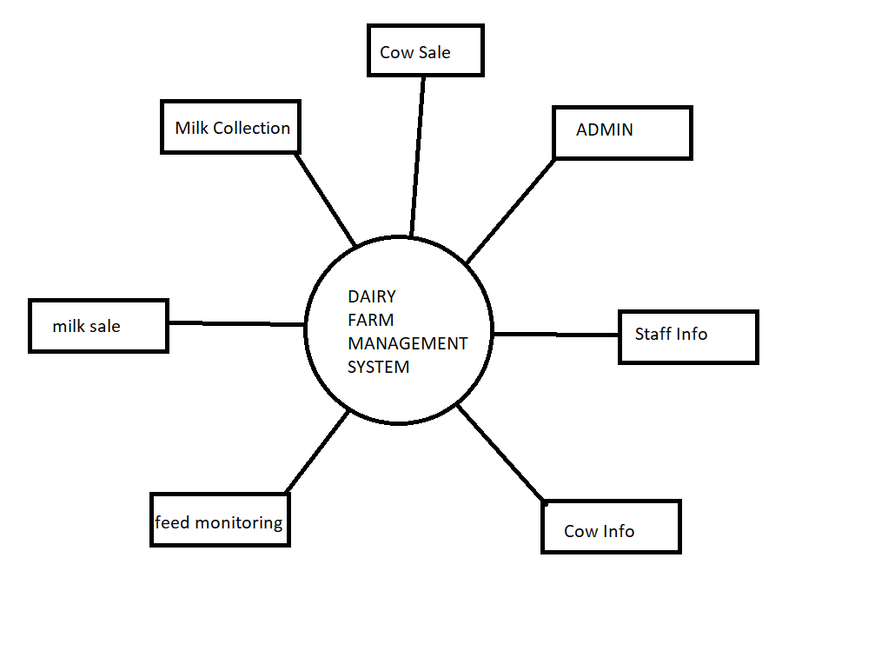
CONTEXT LEVEL DFD

Slide 6
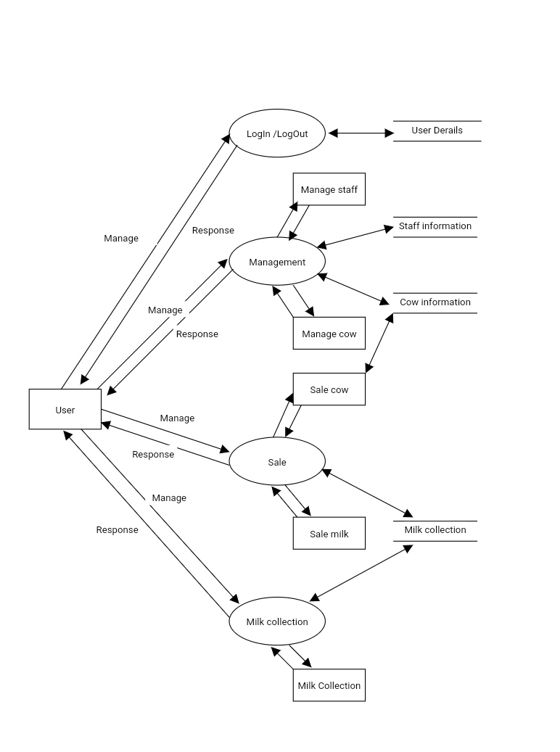
FIRST LEVEL DFD

Slide 7
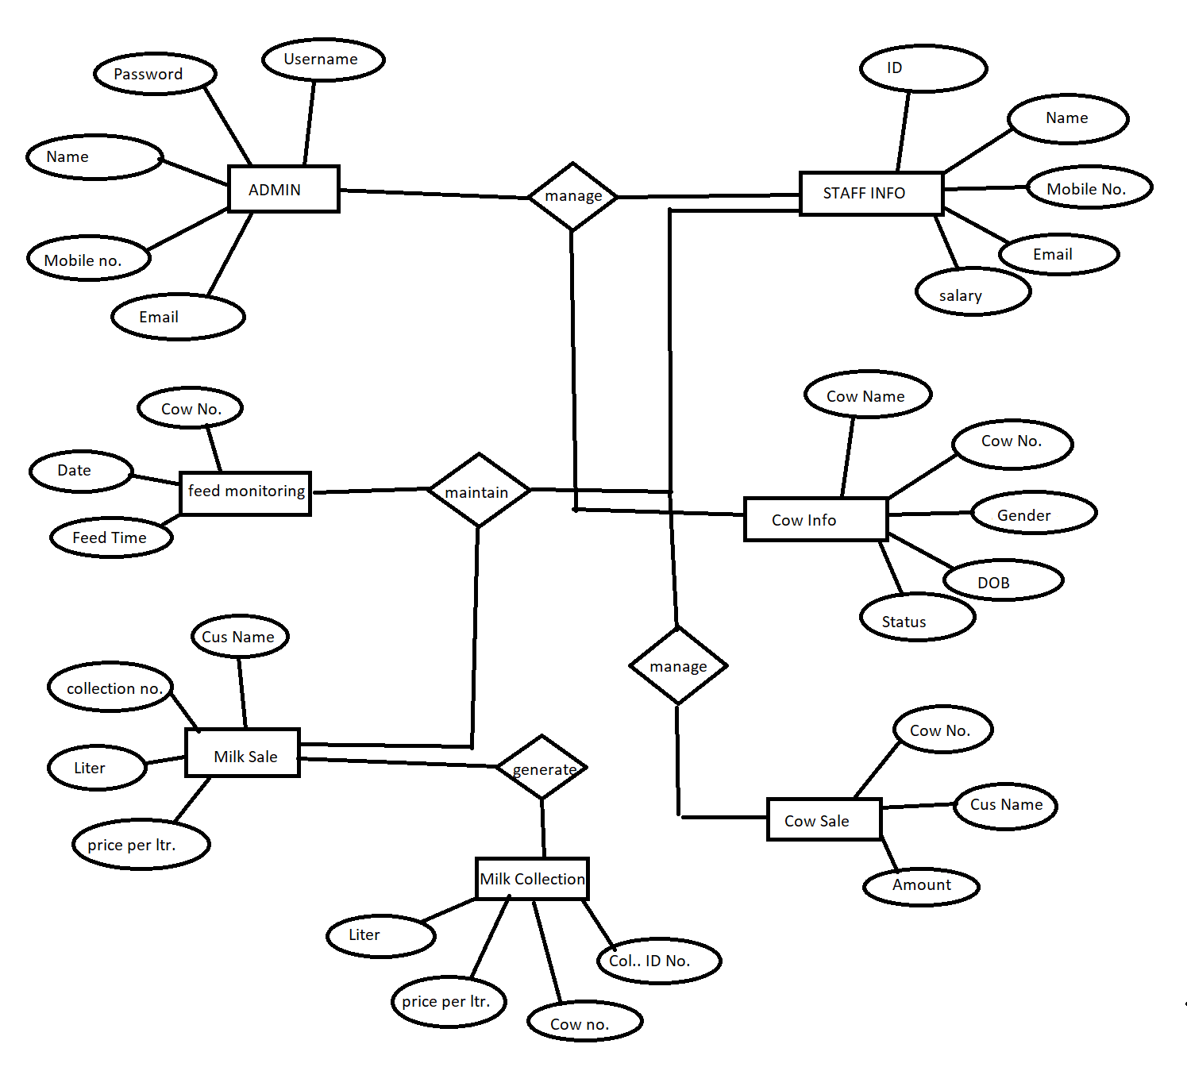
E-R DIAGRAM

Slide 8
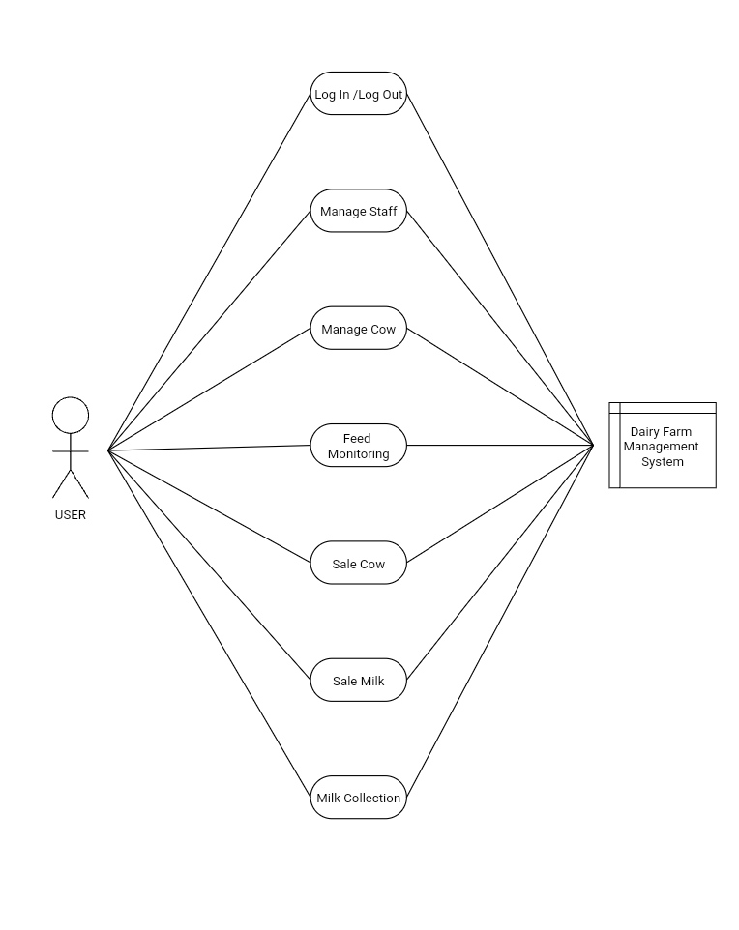
USE-CASE DIAGRAM

Slide 9
CONCLUSION
All the cow's need should be supplied in its immediate environment so that the cow's energy is devoted to milk production. The dairy industry has to integrate the feeding system, genetic data, advanced milking system, milk transport and processing facilities, administrative tasks, and skilled manpower.

Slide 10
THANK YOU

Slide 11
OPEN PROJECT

